Slide 1

Final Presentation Project Graph Visualization
Prosus AI team
Ramon Dijkstra
17-05-2021

Slide 2

Table of content
Goal of the project
Pipeline
Comparison to other approaches
Final Visualization
Further Improvements
Questions

Slide 3
Main goal of the project
A pipeline from raw data to an interactive visualization that shows clusters of companies and investors.

Slide 4
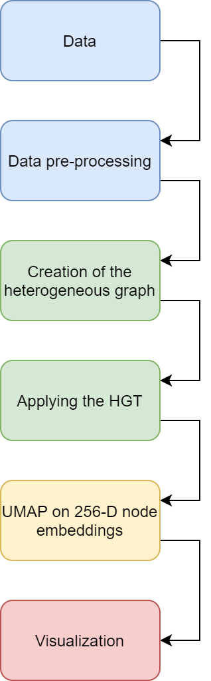
Pipeline
From raw data
to
an interactive visualization

Slide 5
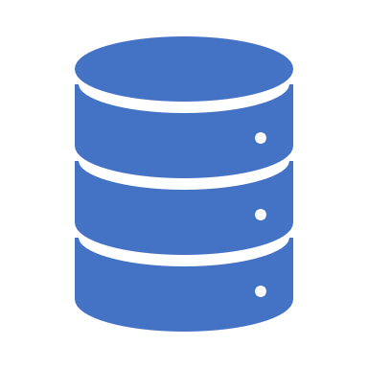
Data
Company.dat
Investor.dat
InvestorInvestmentRelation.dat

Slide 6
Data pre-processing
Only use the data instances that contain metadata
From the 18377 investor data instances we can only use 7883.
From the 11377 company data instances we can only use 9779.
From the 519123 relation edges we can only use 55189 edges.

Slide 7
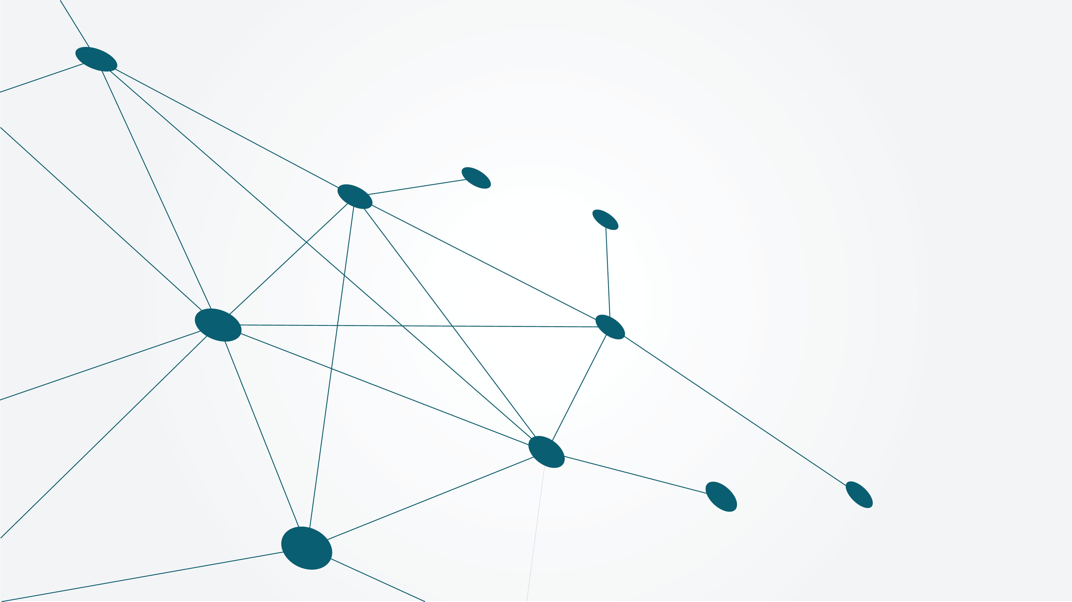
Creation of the Heterogenous Graph
Some investors are also companies
Same relation
Different relation

Slide 8
Applying the Heterogeneous Graph Transformer (HGT)
Features: investors
Labels: companies
Train to guess if an investor invests in a company

Slide 9
Dimensionality reduction technique UMAP
256-dimensional embeddings
2-dimensional embeddings

Slide 10
Other approach by intern Carlo Harprecht
Training objective: funding round prediction in the next 12 month (binary)
Company, investor and relation data
Additional data about the position of people within the company

Slide 11
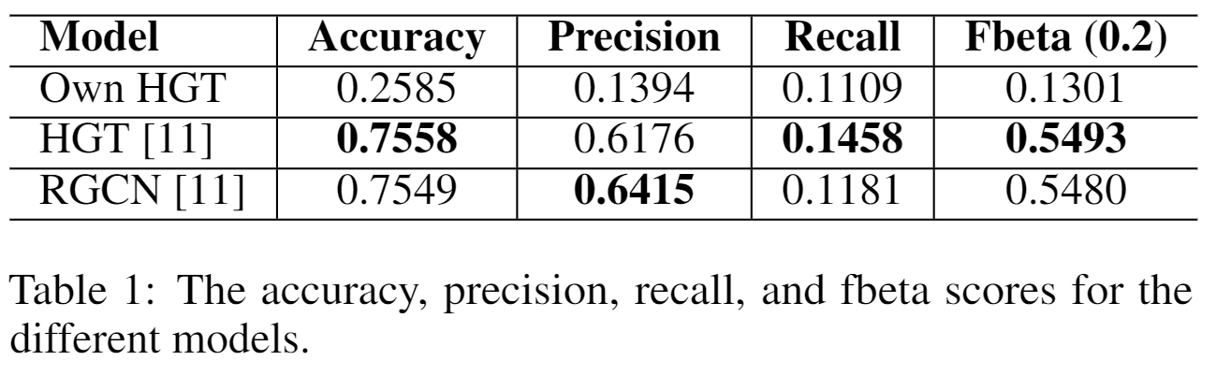
Quantitative comparison to other approaches by intern Carlo Harprecht

Slide 12
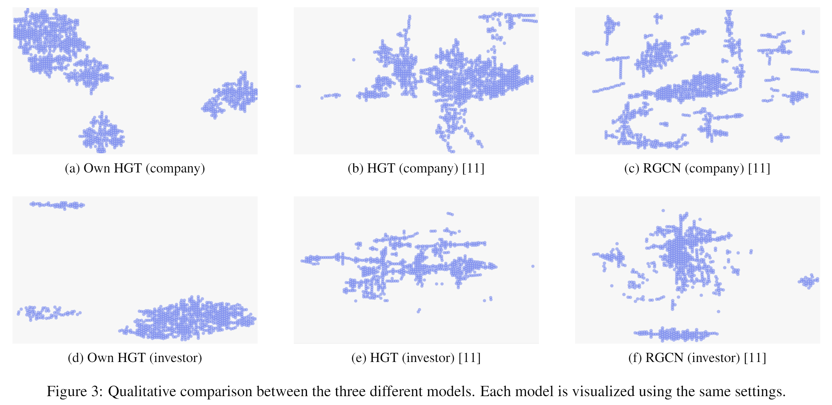
Qualitative comparison to other approaches by intern Carlo Harprecht

Slide 13
Sub-goals of the project
SG1: The user should be able to see a clear overview of the companies and investors.
SG2: The user should be able to explore regions of interest.
SG3: The user should be able to find specific details for companies and investors.

Slide 14
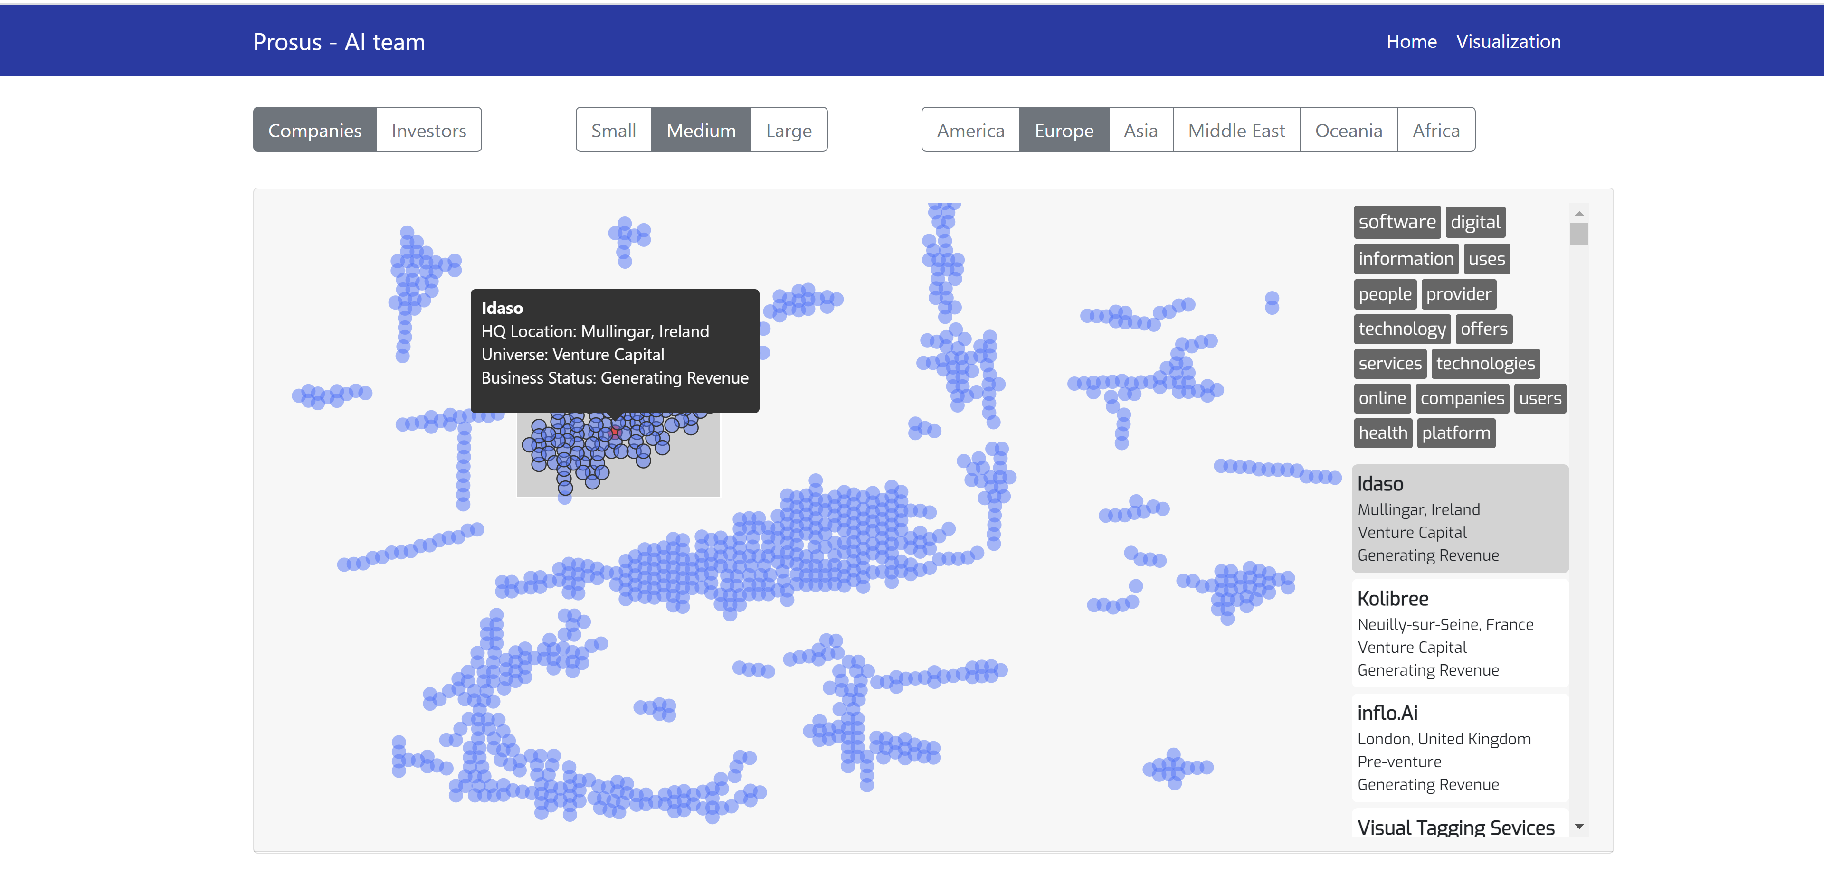
Final Visualization

Slide 15

Further Improvements
Search function
Links between companies and investors
Task specific embeddings

Slide 16

Questions

